Slide 1



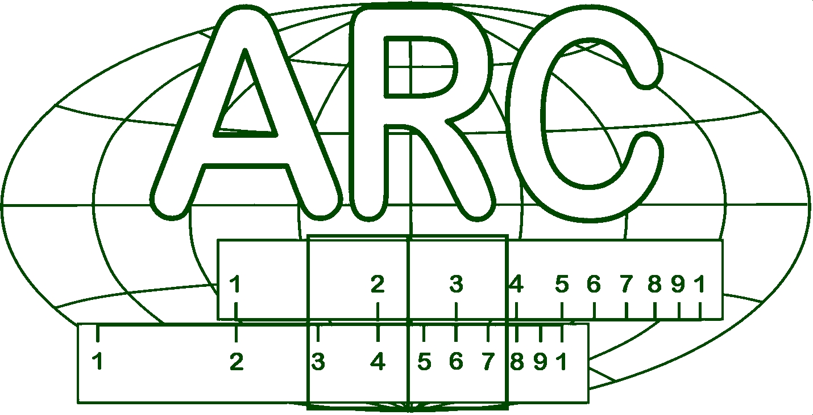
Measuring Slide Rule

Slide 2
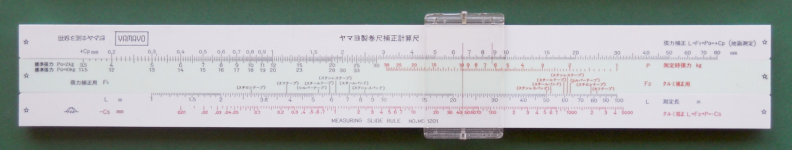
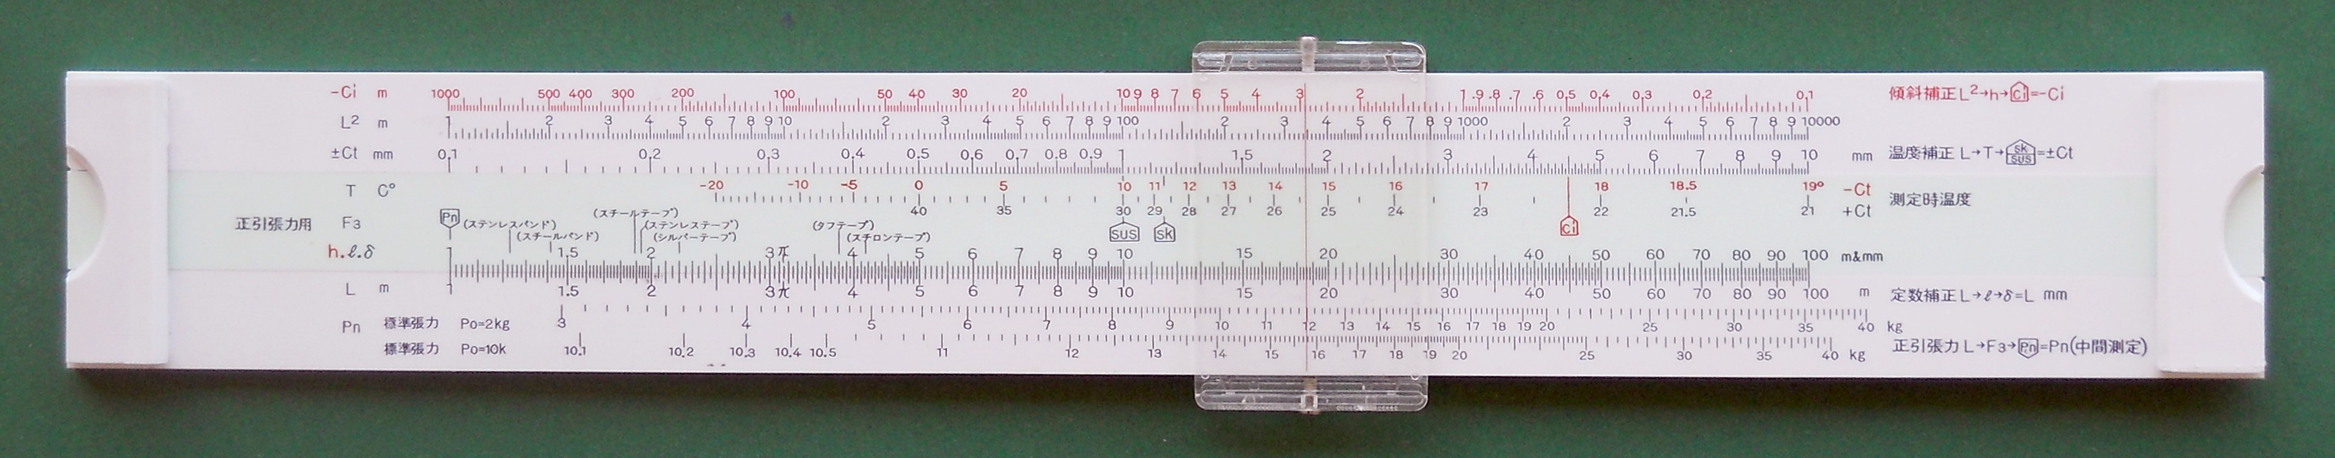
The Specimen
MS 1201
20 cm (7.9 inches)
32.4 cm (12 ¾ inches)

Slide 3

The Products
（ステンレステープ） | (Stainless tape)
（ステンレスパンド） | (Stainless band)
（スチールテープ） | (Steel tape)
（スチールバンド） | (Steel band)
（シルバーテープ） | (Silver tape)
（タフテープ） | (Tough tape)
（スチロンテープ） | (Stylon tape)

Slide 4



Measuring…
Tension
Temperature
Nominal Conditions: 20 ºC, 2 kgf
(10 kgf)
Weight

Slide 5



Temperature - Ct
Ct = L · Kt · (T – T₀) (result in mm)
L = measured length (m)
T = measured temperature (ºC)
T₀ = nominal temperature (20 ºC)
Kt = tape temperature coefficient (mm/m·ºC)
Stainless Steel Kt
Steel Kt
Ct
T
L
Rear side, scales “L”, “T” and “± Ct mm”
Reading of 30 m at 15 ºC with steel tape?

Slide 6
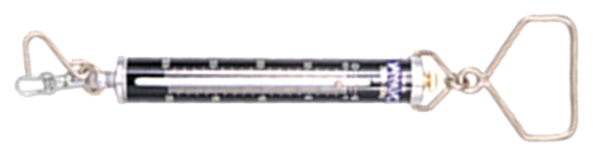
Tension - Cp
Cp = L · Kp · (P – P₀) (result in mm)
L = measured length (m)
P = tension at measurement (kgf)
P₀ = nominal tension (2 kgf or 10 kgf)
Kp = tape tension coefficient (mm/m·kgf)
Cp
P₀=2kg
F₁
Silver Tape
L
Front side, scales “L”, “F₁”, “P₀=2kg” and “+ Cp mm”
Reading of 50 m at 10 kgf with silver tape?

Slide 7
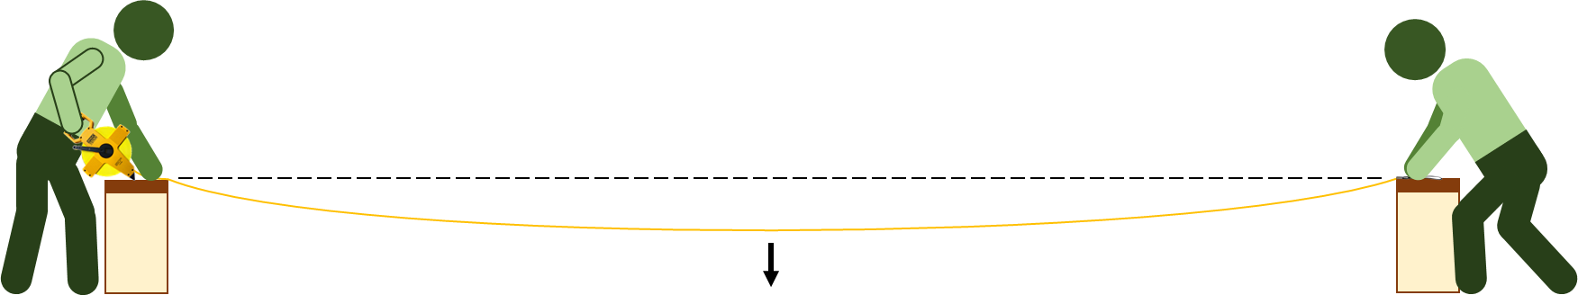
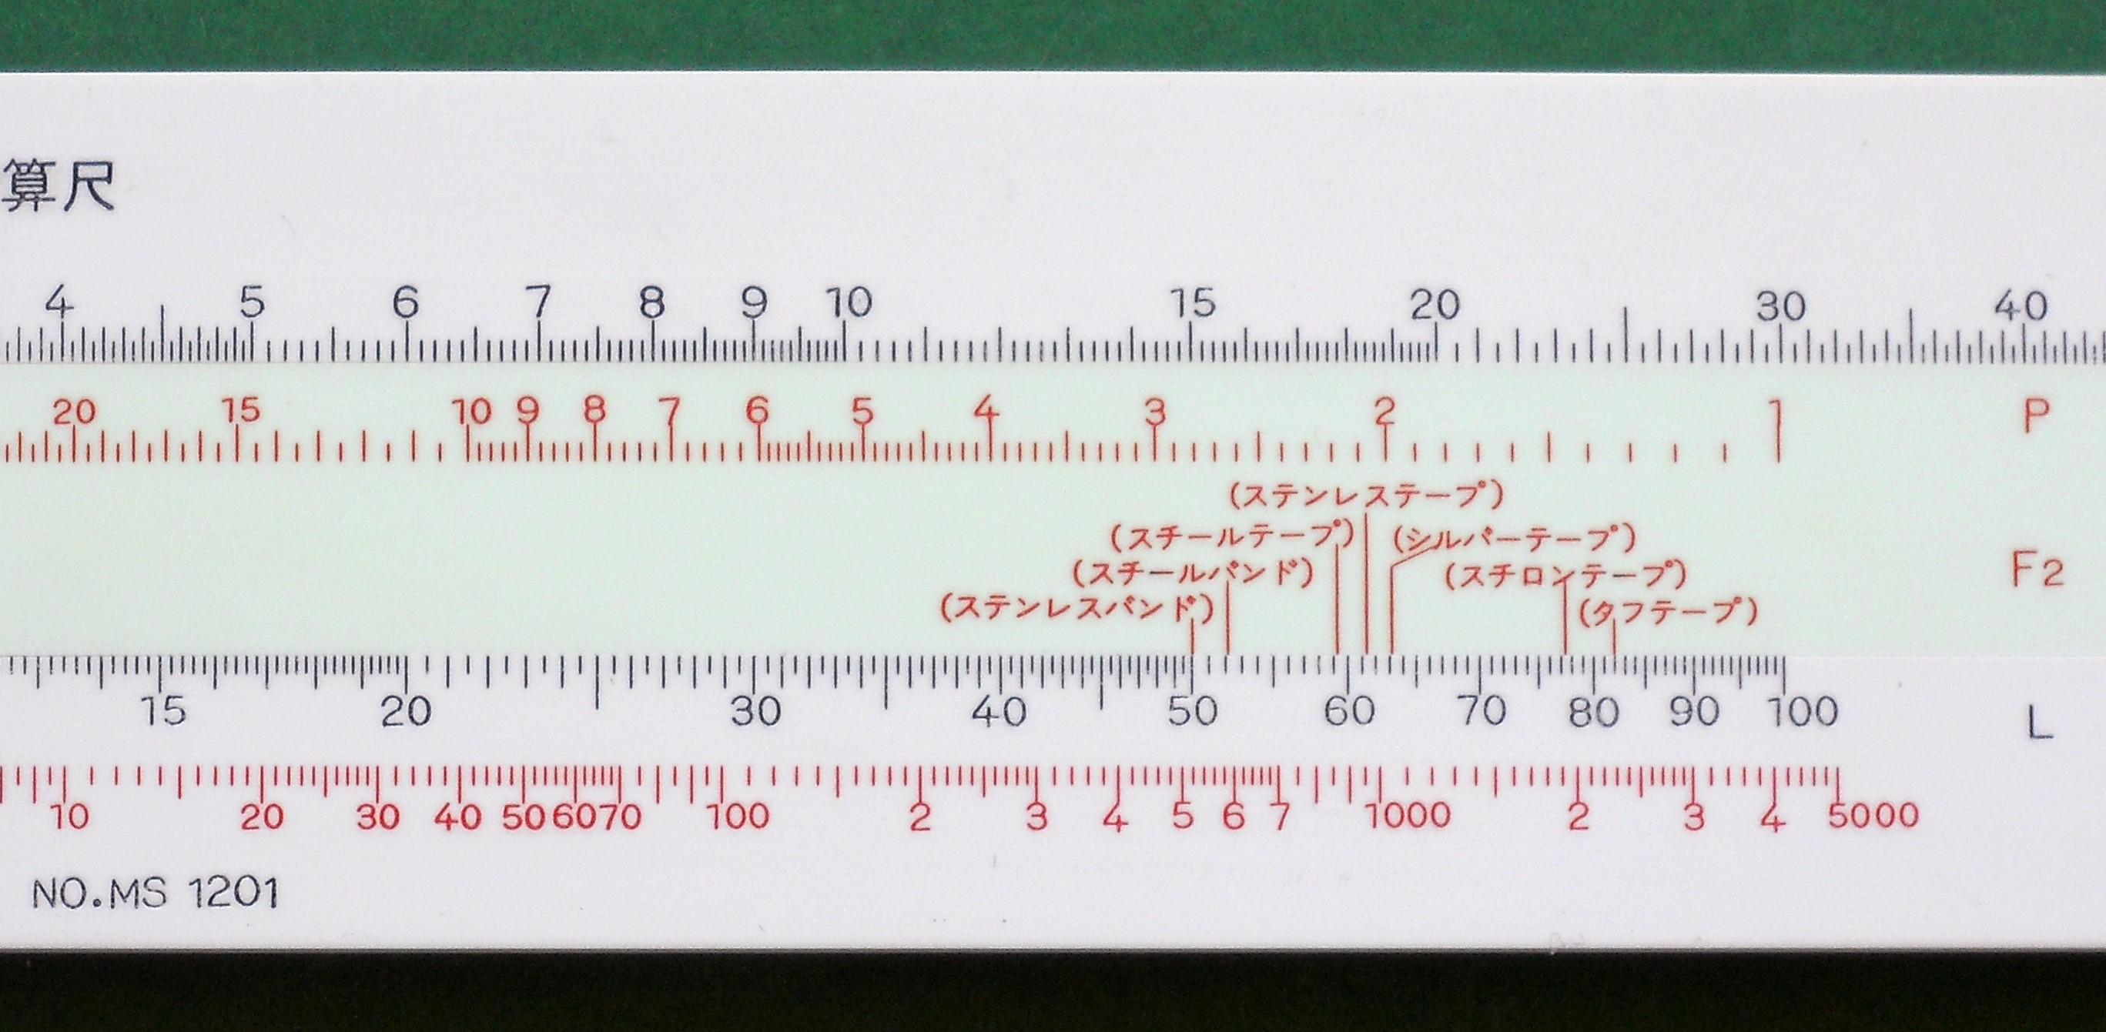
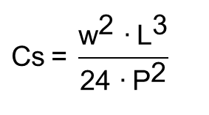
Looseness - Cs
$$\text{Cs} \text{=} \frac{{\text{w}}^{\text{2}}\text{ ∙} {\text{L}}^{\text{3}}}{\text{24 ∙} {\text{P}}^{\text{2}}}$$
L = distance between the support points (m)
P = tension (kgf)
w = weight per unit length of measuring tape (gf/m)
Reading of 50 m at 15 kgf with stainless band?
Stainless Band
Cs
Front side, scales “L”, “F₂”, “P” and “- Cs mm”

Slide 8
Positive Tension - Pn
L · Kp · (P – P₀) = $\frac{{\text{w}}^{\text{2}} \text{∙ }{\text{L}}^{\text{3}}}{\text{24} ∙ {\text{P}}^{\text{2}}} \underset{⇒}{} \text{Kp}\text{ · (}\text{P}\text{ – }\text{P}\text{0}\text{) = }\frac{{\text{w}}^{\text{2}} \text{∙ }{\text{L}}^{\text{2}}}{\text{24}\text{ ∙ }{\text{P}}^{\text{2}}} \underset{⇒}{} \text{P}\text{ ∙ }\sqrt{\text{P}−{\text{P}}_{\text{0}}}= \frac{\text{L}}{\text{Kn}}$
Reading 30 m with tough tape?
F₃
(Tough Tape)
L
Pn
P₀=2kg
Rear side, scales “L”, “F₃” and “Pn kg”

Slide 9
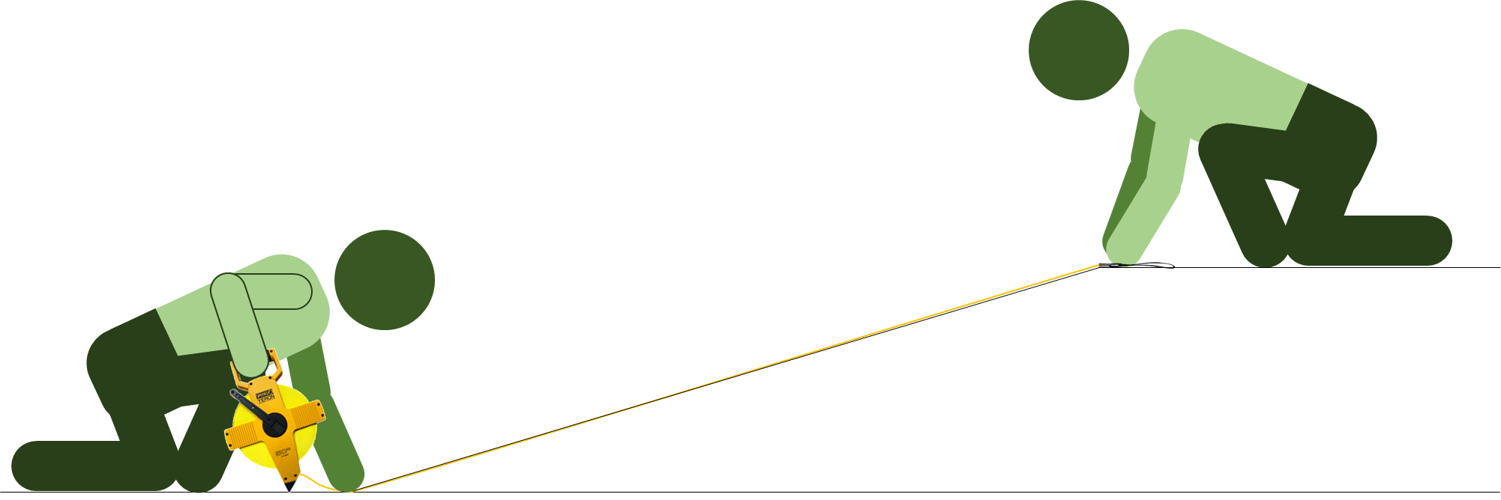
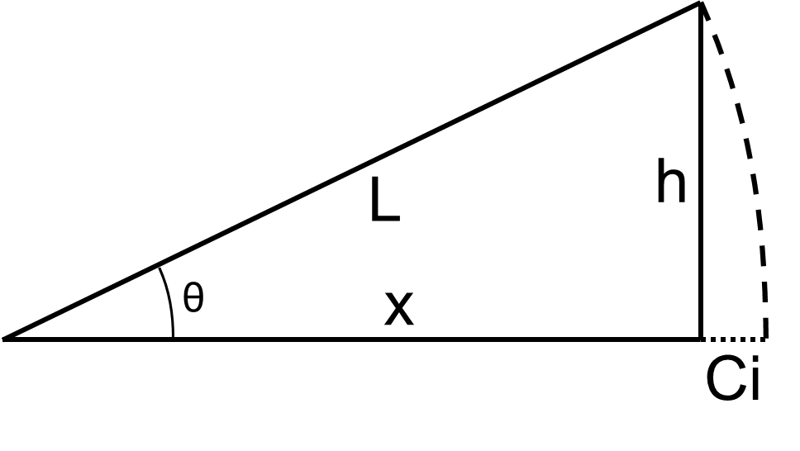
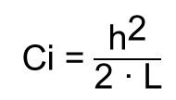
Inclination - Ci
Ci = $\frac{{\text{h}}^{\text{2}}}{\text{2 ∙ }\text{L}}$
Reading of 30 m with height difference of 8 m?
Ci
L²
h
Rear side, scales “L²”, “h” and “- Ci m”

Slide 10
Compensation Examples
When the results are worth the effort?
Factor |  | Measurement | Correction | Result
Temperature | Ct | 30 m | 1.72 mm | 29.99828 m
Tension | Cp | 50 m | 7.6 mm | 50.0076 m
Looseness | Cs | 50 m | 18.1 mm | 49.9819 m
Positive Tension | Pn | 30 m | 7.1 kgf | 30 m
Inclination | Ci | 30 m | 1.05 m | 28.95 m

Slide 11
Scales Standardization
Front Side |  |  | Back Side
Scale Name | Scale Type |  | Scale Name | Scale Type
 |  |  | -Ci | AI² (shifted)
 |  |  | L² | A²
+Cp | A (shifted) |  | ±Ct | A (shifted)
Tension (P₀=2kg)/(P₀=10kg) | B* (shifted) |  | T (<20ºC/>20ºC) | BI*
P | 2/3BI |  | F₃ | B
F1 - F2 | BI - 2/3BI |  | h.ℓ.δ | B
L | A |  | L | A
-Cs | A³ (shifted) |  | Pn (P₀=2kg) | “A + D” (shifted)
 |  |  | Pn (P₀=10kg) | “A + D” (shifted)
(*: with special numbering)

Slide 12
Slide Rule Dating
Yamayo Webpage History Key Milestones
Slide Rule Possible Milestones
1959: Approved factory for steel tape with JIS labeling
possible starting of slide rule usage
1966: Stylon tape commercialization
1968: Silver tape commercialization
Possible starting of model slide rule design
1972: -
1988: Head office moved from Nihonbashi to Adachi
Specimen last possible year of manufacture
1989: Release of ready-to-use surveyor calculator
Possible end of slide rule ordering to Fuji
1990: Stylon, Million, Pro Series full model change
Possible end of slide rule commercialization
Slide Rule Manual Data
…”The above table was standardized in February 1972”…
Specimen first possible year of manufacture
…”Head Office … Nihonbashi Honcho”…

Slide 13


Thank You!

